Slide 1
Letter of Credit using Blockchain Technology
Keval Bhanushali
Neha Puthran
Ronit Shetty

Slide 2

Problems in traditional approach
Lack of streamlined process
Manual touchpoints due to lack of automated workflow
Lack of transparency in operation and business policy
Absence of a one stop view portal & real-time status
Time consuming end-to-end process

Slide 3
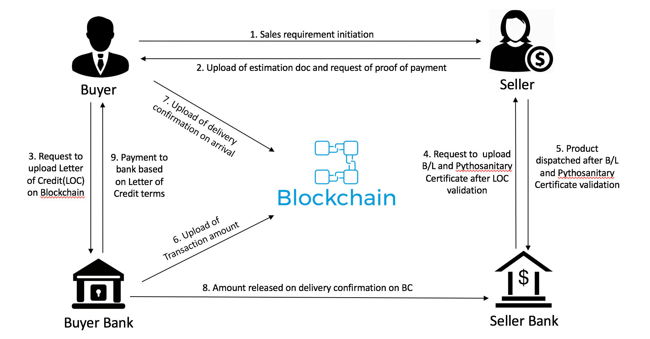
Business Workflow

Slide 4
How does blockchain help?
Automated workflow and business policies
Reduced manual work
Transparency in the process, workflow more streamlined
Speeds up time, hassle free

Slide 5
Workflow
1. Sales requirement initiation
2. Upload of estimation doc and request of proof of payment
Buyer
Seller
7. Upload of delivery confirmation on arrival
3. Request to upload Letter of Credit(LOC) on Blockchain
9. Payment to bank based on Letter of Credit terms
4. Request to upload B/L and Pythosanitary Certificate after LOC validation
5. Product dispatched after B/L and Pythosanitary Certificate validation
6. Upload of Transaction amount
8. Amount released on delivery confirmation on BC
Buyer Bank
Seller Bank

